Slide 2
Final Conference
Mövenpick Hotels & Resorts-Dead Sea
September 25th, 2019
Jordan
Commercialization of Research Products
Thanos Contargyris, CRE.THI.DEV., Greece

Slide 3
Commercialization of Research Products
How Universities can get revenues from their R&D activities?
1. Public subsidies or contracts: criteria which can be far from market’s interests and exploitation possibilities and may orient R&D to not easy to commercialize results.
2. Private donations or contacts: Can be a good source of revenue but the counterparts can imply that the R&D results will be exploited by the companies providing the donation (outside the area of the university).
3. Patenting and Licensing : It is the most popular way of commercialization of an idea as it and the easiest for innovators who do not whish to work on commercialization.
4. Create spinoffs: the commercial exploitation of scientific and technological knowledge is realized by university scientists (teachers or researchers), students and graduates.

Slide 4
Commercialization of Research Products
What are the cooperation schemes the private sector prioritises?
Consultancy contracts for the valorisation/commercialisation of results of fundamental research
Research projects with Universities or Researchers for applied research
Joint commercialisation projects of a product or a process (licensing agreements)
Buy a patent

Slide 5
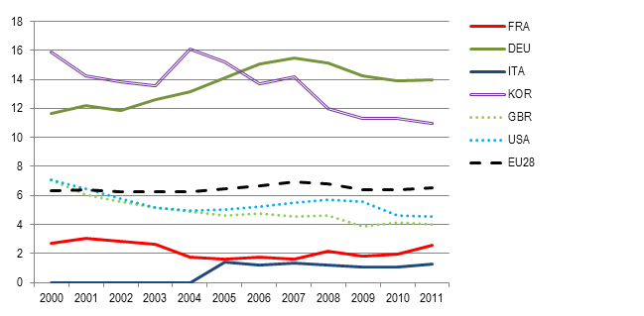
Commercialization of Research Products
What revenues can be expected by Universities from private sector?
Historically, the % of the Research budgets of universities funded by private sector is in EU or in US about 5% or 6%; the only countries with better results are Germany and Korea.
The figures are even lower if we consider uniquely the commercialisation of research results.

Slide 6
Commercialization of Research Products
Benefits to be expected from the commercialization of Universities R&D
• Social Benefits: in areas such as healthcare it impacts greatly the every-day life of people
• Generation of new companies or investments which produce economic growth
• Commercialization develops industry partnership (through license agreements or incubators)
• The publicity that comes from an innovation, a new product which was invented and commercialized will attract new people in the area and in the university, therefore research’s commercialization is a factor of recruitment
• It also brings entrepreneurship to the area and to its university

Slide 7
Commercialization of Research Products
Process for enabling the commercialising of Research Products
Identify exploitable R&D results (from Pure or Applied Research): push researchers to reveal their results, internally, to structures (TTOs) able to evaluate their possible exploitation
Evaluate their possible markets and the required R&D work (Additional pure research or applied research) to convert results into commercial products for these markets
Identify what funding scheme is the most suitable to convert Results in Products
Self or university funding
Crowdfunding
Corporate funding
Public funding

Slide 8
Commercialization of Research Products
Decisions to take before launching the commercialising of Research Products
Negotiate/Decide/plan steps of disclosure of Results and protection of Products
Publication – for university/public funding - risk of limiting exploitation possibilities
Patenting – in view of disclosure for crowdfunding or corporate funding
Licensing – for negotiation of corporate funding or create spinoff
Decide the commercialisation scheme of the expected Research Product:
lease research result/product as it is (find a company interested to buy a patent or negotiate a license agreement)
create a spin-off to exploit the market potential of the research product

Slide 9
Commercialization of Research Products
Why Spinoffs creation is the best solution for the local area served by the University
Spinoffs are created by university professors or student doing their thesis (people from the public sector deciding to go the private one) : a loss for both universities and local areas? No! Spinoffs tend to balance that with the way they are doing business:
spinoffs use labs and incubators from the local area or from the university, they bring new ideas and help these incubators and labs to be effective, they also sometimes contribute to the maintenances of these infrastructures via fees.
spinoffs located in an area will produce in this area. To produce they employ people from this area. These employees will then help the economic growth of the area. By creating more new jobs than industry startups, university spinoffs are offsetting their higher social cost, at least to some degree.
Spinoffs frequently serve as catalysts for the formation of geographic clusters of new firms in particular technologies.

Slide 10
Commercialization of Research Products
Why Spinoffs creation is the best solution for universities
Spinoffs are more interesting than the other types of commercialization procedures for universities as
they maintain a certain aspect of control, a voice in the process of creating and commercializing the idea, because the idea is mainly done inside the labs or incubators of the university.
they get equity from a spinoff which usually is far greater than a license agreement: they can use it to supplement their salaries with equity in their own companies, universities provide a financial mechanism to retain and recruit faculty, particularly in the biomedical areas, where this approach is similar to the use of practice plans common with clinical faculty in medical schools.

Slide 11
Commercialization of Research Products
How to promote/ develop spinoffs as a university TTO
The norm in TTOs: innovators need to bring their ideas to the TTOs to find if there is a possible commercialization prospect for their innovation.
The problem: many innovators do not show up to the TTOs and the commercialization of many products and innovations is not even analyzed.
A solution: involve TTOs a bit sooner in the research. The different representatives of a TTo should work hand in hand with the innovators, not necessary at the beginning of research but certainly prior to any publication, to understand the different possibilities of commercialization that could arise from the research conducted.
This process implies that it is not the innovators that come by the TTO but the exact opposite. Being from early on in the process of a research the TTO will, therefore, have more time to work on the best possible strategy to protect IP and to generate resources for the innovator and the university.

Slide 12
Commercialization of Research Products
Possible limits to be faced by a pro-active identification of exploitable results
The limit: too many people would be needed in a TTO to analyze every bit of research done at a point t in time.
Possible solution: the collaboration of different schools and/or different universities and TTOs for the analysis of exploitable R&D results identified.
Suggestion: create, for each exploitable R&D result, a dedicated task force to assist the inventor: a group of multidisciplinary- students, 1 business Professor, 1 Professor of Science in the R&D field of the innovator and external experts with business experience of the targeted markets. The task force will deliver market and feasibility studies and business plans.
The participating students will be graded on the quality of their report (by the 2 professors and at least one external expert). If the task force work allows to create a spinoff, its members will be offered equity as a prize…

